Slide 1
NCH - Pediatric MATCH – Proposed Workflow
Version 2.0
Heather Day, BPC Informatics

Slide 2
Requirements
Surgical Event ID
assigned to tissue (slides or blocks) received at the bank
based on information, patientID, studyID, specimen type, collection date & SPID) received from collection source site
Only assigned for tissue
Included in message, shipping manifest
Molecular IDs
Molecular ID is assigned to all aliquots with a common parent/shipment ID
Separate molecular IDs are DNA and cDNA (i.e. 00012D, 00012C) will be included in message, shipping manifest, labels
Blood is assigned a different Molecular ID (i.e. 00013D)
A new Molecular ID is assigned when new aliquots are shipped

Slide 3
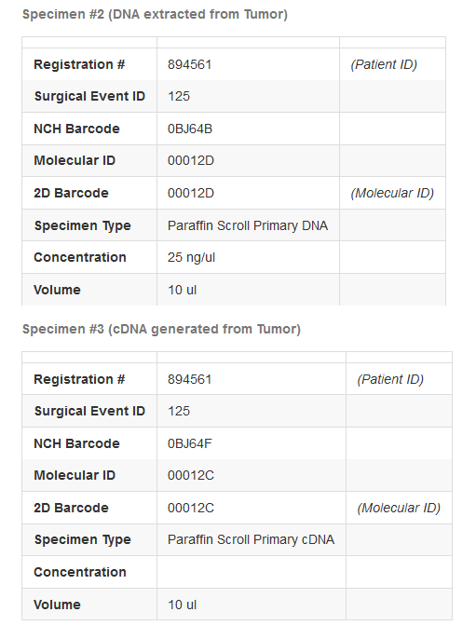
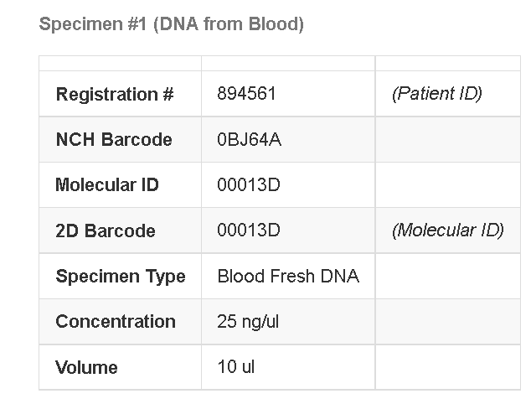
Specimen Labels

Slide 4
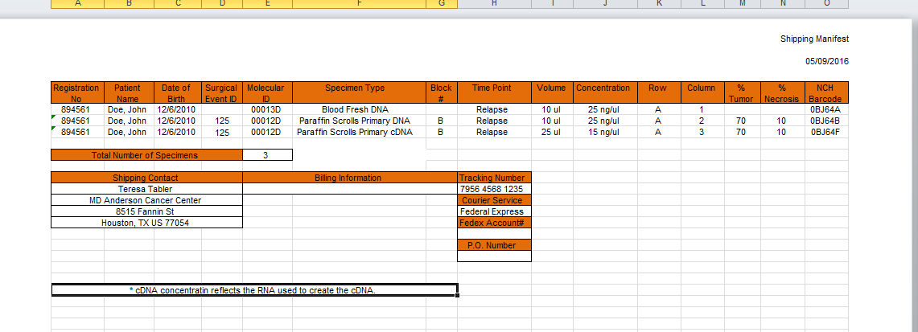
Sequencing – Shipping Manifest Example
Patients will be batch shipped, if there are 2 (or more patients)
the barcodes will be side by side at the bottom of the page.

Slide 5
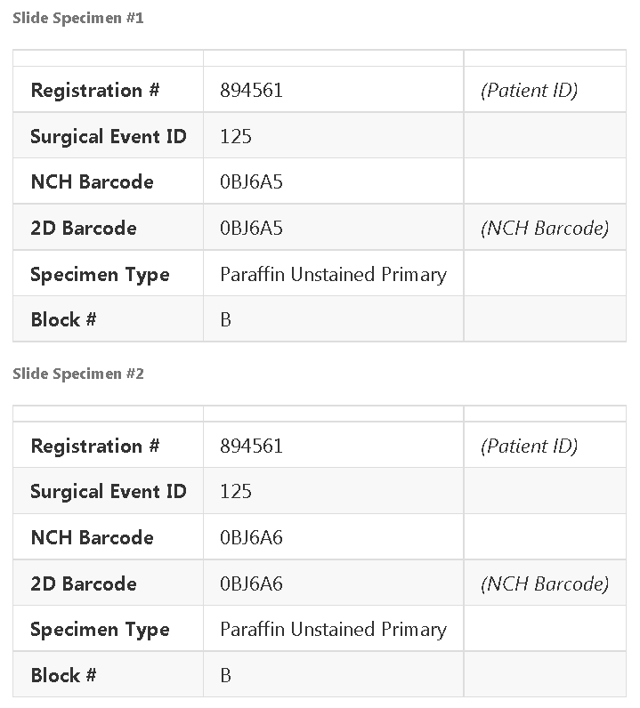
Slide Labels
125
(Surgical ID Barcode)
125
(Surgical ID Barcode)

Slide 6
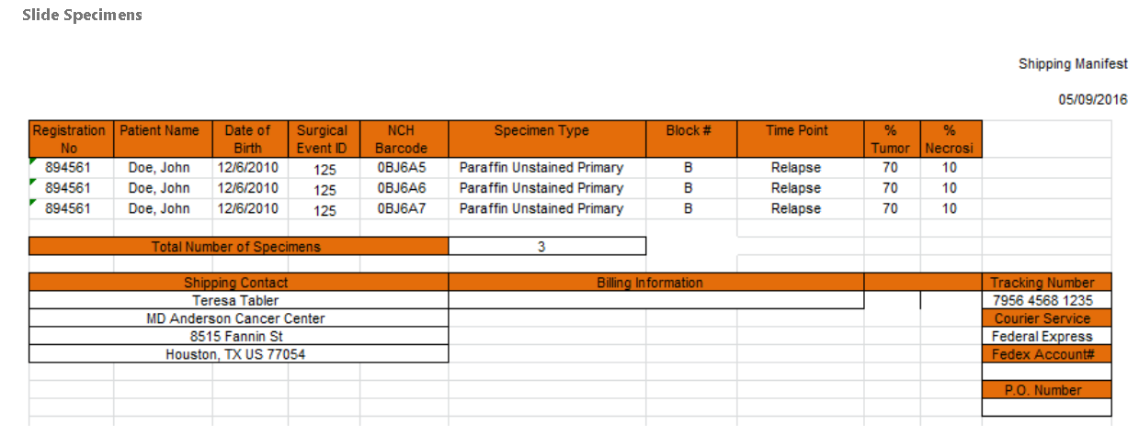
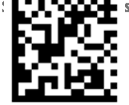
Slides – Shipping Manifest Example
Patients will be batch shipped, if there are 2 (or more patients)
the barcodes will be side by side at the bottom of the page.

Slide 7
(all specimens received, processed and shipped no variation)
Patient enrolls on APEC1621.
Message sent to matchbox, COG Registration.
Pediatric match email group receives enrollment notification.
BPC receives blood and tumor block (FFPE).
BPC accessions specimens and documents in STARS.
BPC sends specimens to CM and MGL for processing.
MGL extracts and QC DNA from blood specimens.
Core Morph cuts slide from tumor block (FFPE).
BPC picks up tumor block, stained slides and unstained slides.
BPC takes slides to Pathologist for review and slide annotation.
Pathology enters results into path form (VIPER).
BPC takes H&E annotated slides and unstained slides back to CM for macro dissection.
BPC coordinator receives paperwork from the previous day and QC specimens in STARS.
Surgical event ID assigned to tumor specimen.
Received message triggered to match box.
Core Morph scrapes the tumor section of the slides into a vial.
BPC picks up stained slides and vial of scrapings.
BPC sends vial of scrapings to MGL.
BPC sends annotated stained slides to VM.
VM scans stained slides.

Slide 8
VM makes stained H&E images available to MD Anderson (VIPER or file transfer).
An email notification is triggered to Dr. Hamilton.
MGL extracts DNA and RNA from paraffin scrapings.
MGL creates cDNA and run QC on all nucleic acid specimens.
MGL director performs review of nucleic acid specimens.
BPC creates shipment of slides for IHC to MD Anderson.
A shipped message triggered to Match Box.
MGL Create shipment in STARS > assign specimens.
Molecular ID is assigned.
Relabel specimen vials with sequencing center requirements.
Molecular ID in 2D barcode
Institutional Pathology Report
Treating Physician Report
Shipping Manifest
MGL physically ships and marks shipment in STARS as shipped.
A shipped message triggered to Match Box.
MGL runs identity panel on tumor and blood specimens.
BPC banks stained slides.
Sequencing receives Tumor DNA/cDNA and Blood DNA.

Slide 9
Sequences Tumor DNA/cDNA and Blood DNA.
Matchbox picks up variant report(s) for successful sequencing.
Sequencing lab sends results to (Matchbox file share).
Sequencing lab confirms sequencing results.
Patient information is run for treatment assignment.
Matchbox messages treatment assignment back to COG.
Variation, tumor successful, blood passes, process delayed by second shipment
Sequences tumor DNA/cDNA and Blood DNA.
MATCHBOX picks up variant report for successful blood
sequencing.
Sequencing lab requests more material.
Bank sends more material.
Sequencing tumor DNA/cDNA.
MATCHBOX picks up variant report for successful tumor sequencing.
Sequencing lab sends results to (Matchbox file share).
Sequencing verifies the tumor DNA and Blood DNA.
Germline Clinical Group, to issue clinical report by watching matchbox for a confirmed tumor sequencing report.
Sequencing Lab issues clinical report for tissue.
Matchbox assigns patient treatment.

Slide 10
Variation, tumor successful after blood continues, tumor fails and blood continues
Sequences tumor DNA/cDNA and Blood DNA.
MATCHBOX picks up variant report for successful blood
sequencing.
Sequencing lab requests more material.
Bank sends more material.
Sequencing tumor DNA/cDNA.
MATCHBOX picks up variant report for successful tumor sequencing.
Sequencing lab sends blood results to (Matchbox file share).
Sequencing reports failure on status call (when none left)
Triggering verification of other results or germline clinical reports required
Germline Clinical Group reviews cases in MATCHBOX
Variation: if blood sequencing results only they will issue the clinical report in the absence of tumor results (trigger is a ‘go ahead on the case status call)
Sequencing Lab issues clinical report for tissue.
Matchbox assigns patient treatment.
MATCHBOX picks up variant report for successful blood sequencing.
Sequencing lab requests more material.
Bank does not (site does not) have any more material.
Sequencing tumor DNA/cDNA.
Sequencing confirms result(s) for Blood DNA (or not)
Results are available for later analysis only.
Variation: if blood sequenced first, results issued or analyzed, new material is collected and shipped process repeats, bank will ship tumor to same sequencing lab that ran blood, patient will remain ‘on study’ indefinitely waiting an opportunity for new tx assignment

Slide 11
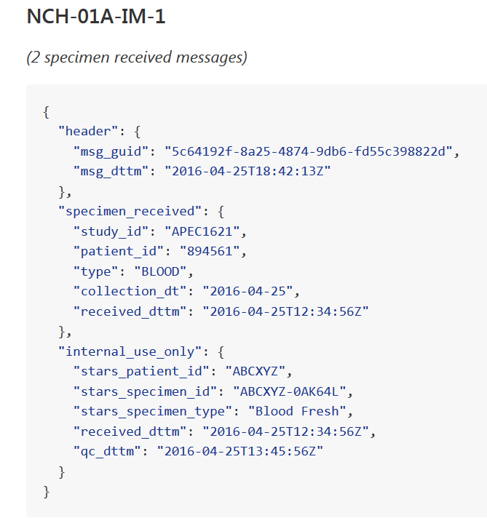
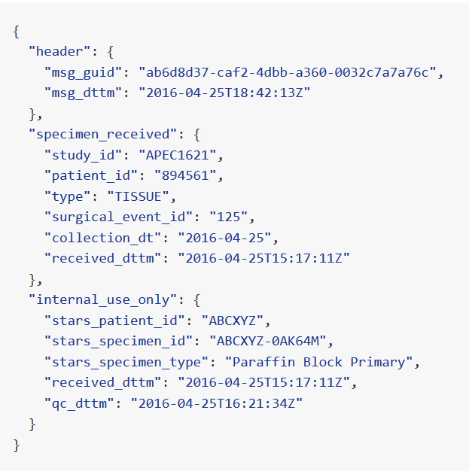

Slide 12
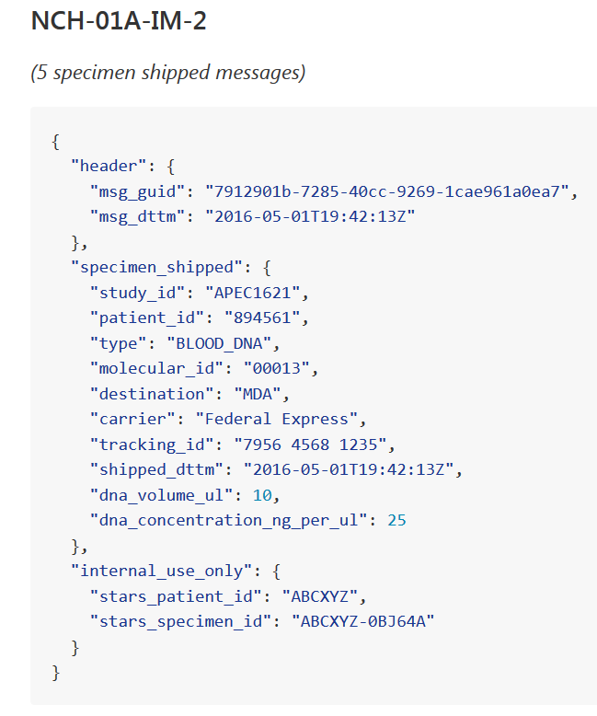
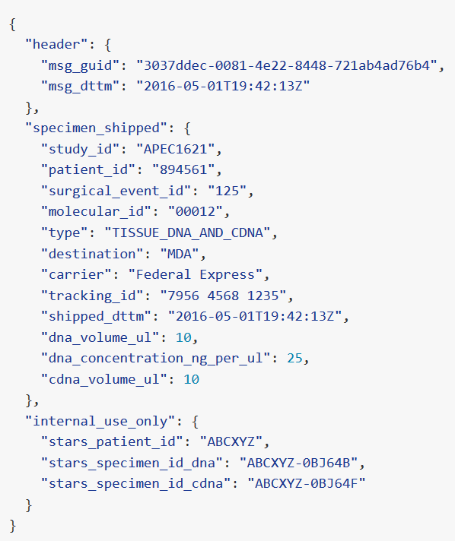
Example Shipped Message – Tumor DNA/cDNA

Slide 13
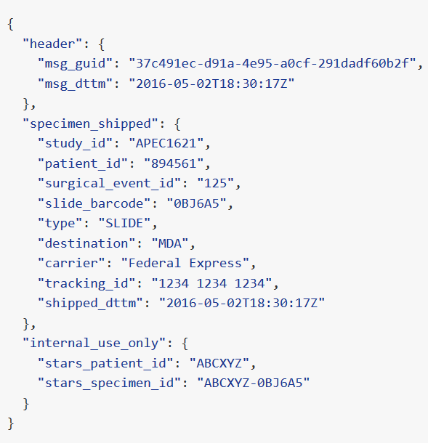
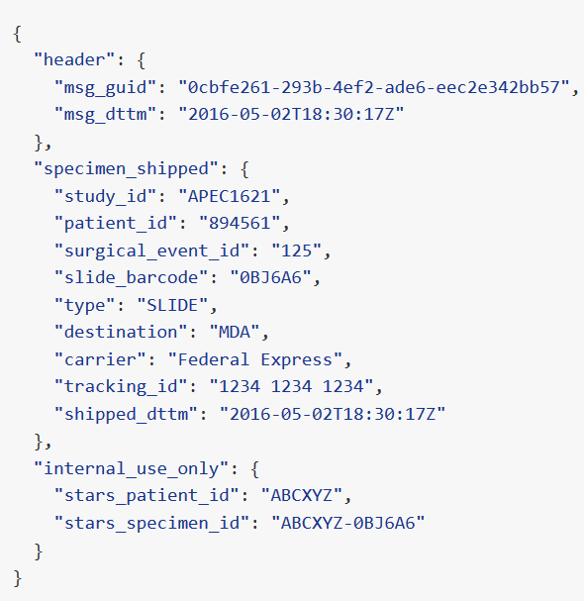
Slides Shipped (2 of 6 examples)

Slide 14
Specimen Failure Handling
No failure messages will be designed or issued to MATCHBOX.
For status tracking, MATCHBOX will hold a meeting to routinely discuss the status (should specimens fail or be delayed) this forum will be used to discuss the appropriate resolution.
Blood results can be accepted into MATCHBOX without DNA or IHC being received (completely separate process)

Slide 15
Forms Handling
Institutional Pathology Report is received at the bank collected with specimen (paper in the box), document will be accessioned into the tracking system along with the specimen transmittal form.
BPC can then download the new report to ensure the most current is part of the shipment.
Specimen transmittal is completed in COG RAVE, printed and put in the box at the institution, paper is received at bank for accessioning (names are hand written); information from this form is input into STARS.
Treating Physician Report is included in the box at receipt, document is accessioned into STARS.
Treating Physician Report is required by COG at enrollment, COG will add a revision date so that they can send a notification to BPC if a new Treating Physician Report is uploaded.
BPC can download the new report to ensure the most current is part of the shipment.
Shipping Manifests are created from STARS, at shipping time and will be sent in the box for MDA and MOCHA (both have requested paper copies).

Slide 16
Shipping Blood
if NCH determines Blood is not available, will send tumor anyway for sequencing to occur (blood is exploratory and not being used for tx assignment)
If NCH receives blood first, the tumor shipments will held (blood will never be sent first by itself)
if NCH never receives tumor, blood will never be shipped
If NCH receives tumor first and blood is delayed, tumor will be shipped ahead so testing can begin. Blood can still ship and be run separate from tumor for a given patient
If NCH does not receive blood with tumor, talk with site, and wait 2 days only (from the time the tumor is received for processing, if the blood does not arrive they will ship tumor and the pipeline continues
If NCH sends Blood after tumor is sent, it should always be sent to same lab as tumor.
if MDA/MOCHA, tumor sequencing fails, blood can continue, results can be sent to MATCHBOX for later exploratory analysis
If MDA/MOCHA, IHC testing results fail, tumor can continue

Slide 17
MATCHBOX validations (for reference)
If the COG fails a case (e.g., a patient goes off trial), any messages we send to MATCHBOX will fail with an error message that indicates the patient is no longer on study. At that point based on the error message we can discard the outbound message from our queue (i.e., stop trying to send it to MATCHBOX).
If the sequencing lab determines that a shipment was “bad”, no explicit message needs to be sent. When the BPC sends out another shipment it will automatically override the previous shipment (Molecular ID).
If NCH needs to fail a specimen after shipments have been made to the sequencing lab, no message will be sent to MATCHBOX, the record will remain until the patient goes off study.
If NCH tries to fail a specimen after the tumor variant report has been created (e.g., we receive additional specimens for some reason), our message to MATCHOBOX will fail with an error message that indicates the case has already progressed past the point of specimen collection. At that point we can discard the outbound message from our queue (i.e., stop trying to send it to MATCHBOX)
If NCH tries indicate receipt of new specimen after the tumor variant report has been created (e.g., we receive additional specimens for some reason), our message to MATCHOBOX will be accepted (without error) even though the case has progressed past the point of awaiting specimen collection.
If NCH tries indicate shipment to the sequencing lab after the variant report has been created (e.g., we receive additional specimens for some reason), our message to MATCHOBOX will be accepted (without error) even though the case has progressed past the point of sequencing shipments.

Slide 18
Follow up on final sequencing workflow
Current project goals for March open date does not include additional tracking or display of case status or an indication of a dramatic delay in the specimen -> sequencing pipelines
Germline clinical results are sent whether tissue sequencing passes or not
Blood results are in MATCHBOX for Will to use at a later time for exploratory analysis (regardless of other failures with tumor)
If Tumor DNA fails sequencing and no more is available, COG decides whether the patient stays on the master protocol (in case more tissue can be obtained) allowed indefinitely (this ‘off study’ triggered the case closure in adult match)
David suggested that there are some reports in the portal that may be able to support the sequencing, germline, labs communication and tracking and what is already available can be looked at after the immediate project goals are met
There was a possibility that if blood sequencing cannot be performed (not yet validated) at the study start, the protocol will open without blood and it will be collected, processed and held or collected, processed, shipped and held.

